Slide 1

How does the supply of Animal Products influence the obesity rates across different countries? Submission Date: 25 -11 - 2024
Group Name: A106 Name of Student Presenting:
Notes:
Welcome to our presentation. Today, we are excited to share the findings of our research conducted around a university area in São Paulo, which examines the impact of temperature on beer consumption among young adults aged 18-28. We hope this study will enlighten us on how climatic conditions influence consumption patterns.

Slide 2
Introduction
Background: This study examines the relationship between animal product supply and obesity rates across countries. Using food supply and health data, it explores how dietary patterns influence public health. The focus is on understanding the role of animal products in the global obesity epidemic.
Purpose: To analyze the correlation between animal product supply and obesity rates. The findings aim to provide insights for policymakers and health organizations in addressing obesity and improving dietary habits worldwide.
Notes:
Our research was initiated to explore whether warmer temperatures correlate with increased beer consumption. Given the diverse climate of São Paulo, understanding these patterns can provide valuable insights for local businesses, especially those in the beverage industry

Slide 3
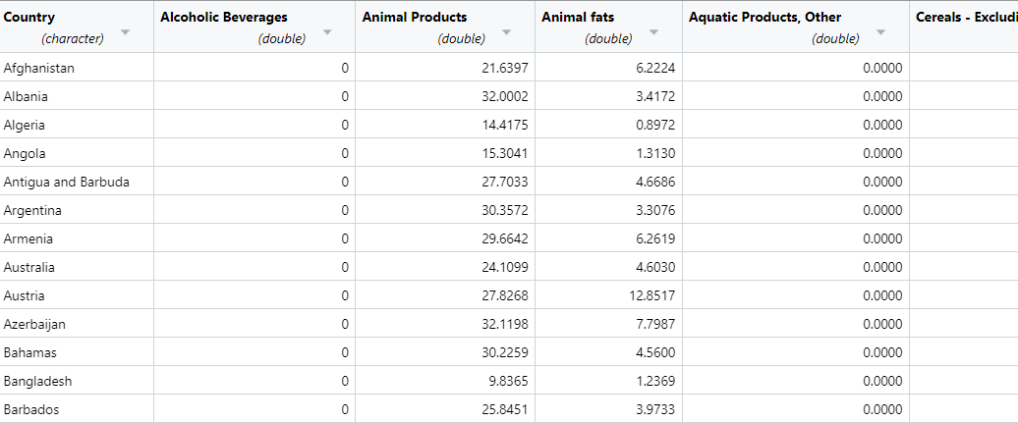
Dataset Overview
Dataset ID: DS163 - COVID-19 Healthy Diet Dataset
Observation Period: Cross-sectional data across 170 countries
No. of Rows and Columns170 rows and 32 columns.
Variables:
Independent Variable: Animal Product Supply (kg/person/year)
Dependent Variable: Obesity Rates (%)
Notes:
The dataset we used spans across 365 days and specifically records daily beer consumption and temperature variations. By analyzing this data, we aim to establish a relationship between the independent variable, average temperature, and the dependent variable, beer consumption in liters.

Slide 4
Research Question: How does the supply of Animal Products influence the obesity rates across different countries?
Our Research Question is
Notes:
The core of our study centers around the question: "How does the average temperature affect beer consumption in liters throughout the year in São Paulo?" Addressing this question will help us understand potential market dynamics and consumer behavior.
You will get only one opportunity to present your Research Question ahead of the submission date. Have your questions ready, and be ready to take notes on feedback.

Slide 5
Null Hypothesis (H₀): There is no correlation between the supply of Animal Products and obesity rates. Alternative Hypothesis (H₁): There is a correlation between the supply of Animal Products and obesity rates.
Hypothesis
Notes:
Our investigation led us to propose two hypotheses. The Null Hypothesis suggests that there is no correlation between average temperature and beer consumption. Conversely, the Alternative Hypothesis posits a positive correlation, implying that higher temperatures might increase beer consumption.

Slide 6
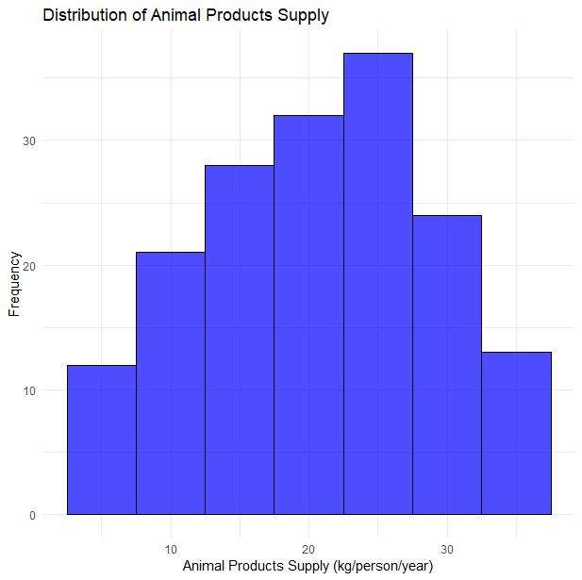
Histogram - Animal Products Supply
The histogram illustrates the distribution of animal product supply (kg/person/year) across countries, showcasing the differences in dietary availability
Notes:
This histogram illustrates the distribution of average temperatures over the year. The somewhat bimodal nature of this distribution points to significant variations in temperature, which could potentially affect consumption patterns.

Slide 7
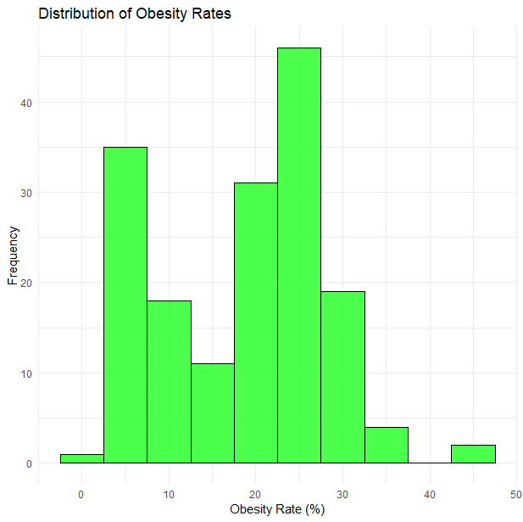
Histogram - Obesity Rates
The histogram shows the distribution of obesity rates across countries, highlighting variations in the percentage of the population affected by obesity
Notes:
This histogram illustrates the distribution of average temperatures over the year. The somewhat bimodal nature of this distribution points to significant variations in temperature, which could potentially affect consumption patterns.

Slide 8
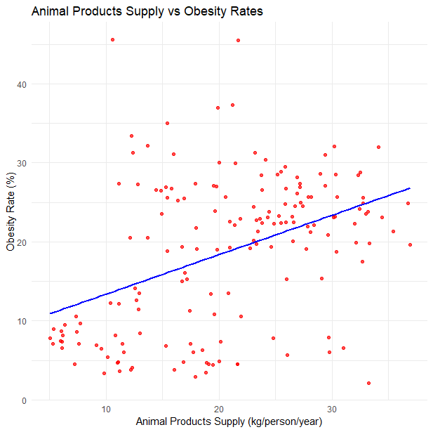
Scatter Plot - Animal Products Supply Vs Obesity Rates
The scatter plot highlights the relationship between animal product supply and obesity rates, suggesting a potential positive correlation where higher supply may correspond to increased obesity levels
Notes:
Displayed here is a scatter plot that maps beer consumption against average temperature. The inclusion of a regression line indicates a positive trend, suggesting that as temperatures rise, beer consumption tends to increase as well.

Slide 9
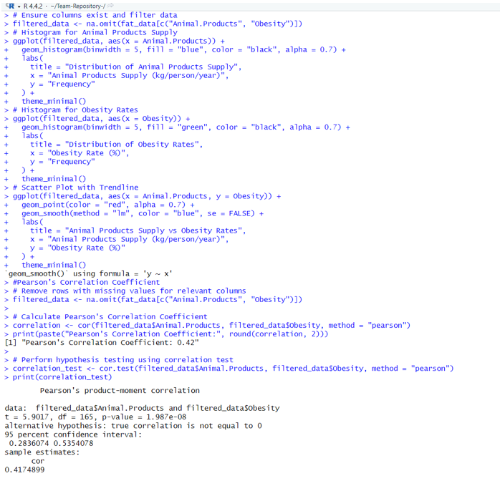
Statistical Analysis
Correlation Test Results:
Correlation Coefficient (r):0.41748
P-value: < 2.2e-16
Interpretation: The Pearson’s correlation coefficient (r = 0.417) indicates a moderate positive relationship between animal product supply and obesity rates. This suggests that higher supply of animal products may be associated with increased obesity rates.
Notes:
To quantify the relationship between temperature and beer consumption, we calculated Pearson’s correlation coefficient. The resulting value of 0.5746 and the extremely low p-value indicate a strong statistical significance, supporting the presence of a positive correlation.

Slide 10
Conclusion
Summary: The analysis reveals a moderate positive correlation (r = 0.417) between animal product supply and obesity rates, supporting the alternative hypothesis. .
Implications: This insight can inform public health initiatives and dietary recommendations, helping policymakers address obesity by focusing on the balance of dietary patterns across countries.
Notes:
To conclude, our analysis confirms a significant positive correlation between average temperature and beer consumption in São Paulo. This finding supports our Alternative Hypothesis and offers actionable insights for businesses in planning and optimizing their marketing strategies according to temperature trends.

